Slide 1
DATA TYPES AND VARIABLES IN PYTHON
BY KARUNWI SIMISOLA

Slide 2
Course Content
Introduction to Variables
Naming Variables
Types Data Types
Type Conversion (Type Casting)
Data Structures in Python
Arithmetic Operations in Python
Comments in Python
Summary
Assignments

Slide 3
Introduction to Variables
Variables are containers that hold information, which can vary or change over time. They are used to store data that can be referenced and changed throughout the program.

Slide 4
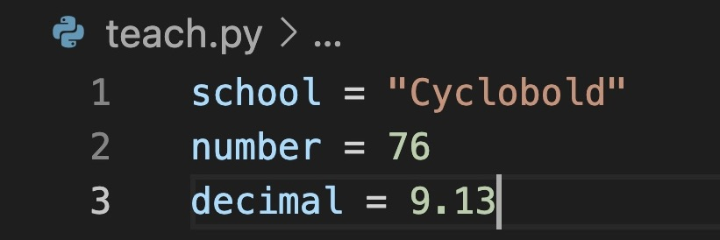
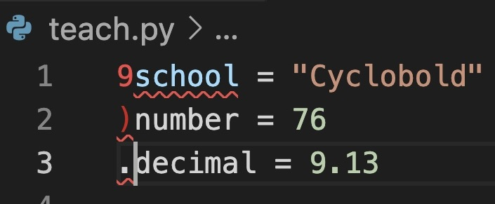
Naming Variables
In python a variable is created using the equals sign.
Variables can not start with numbers.
They can start with letters or an underscore.
Python is a case sensitive language so variables are also case sensitive.
Do not use reserved keywords(if, else…) in python as variable names. It is a bad practice.
Variable Errors

Slide 5
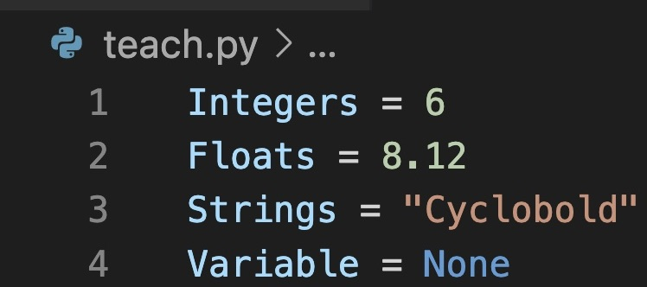
Types Data Types
Integers: They are whole numbers without decimal points.
Floats: They are numbers with decimal points or numbers in exponential forms.
Strings: are characters in sequences enclosed in single or double quotes.
Booleans: represent true or false values
None: represents the absence of a value(null).

Slide 6
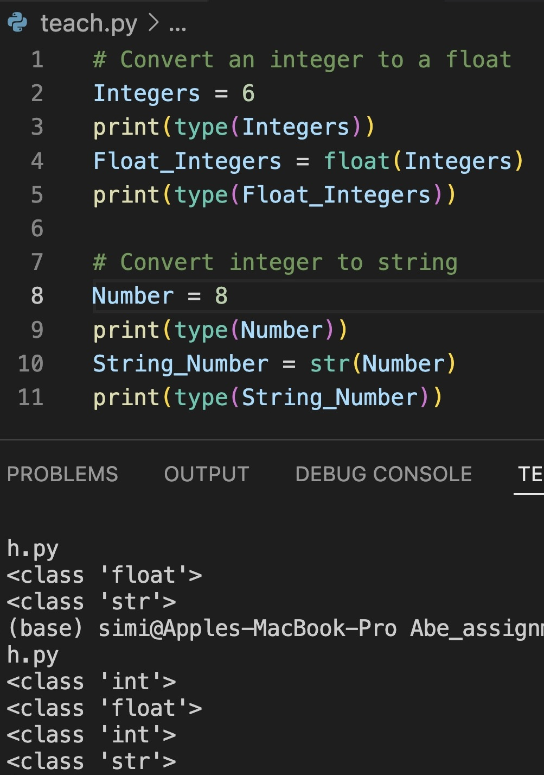
Type Conversion (Type Casting)
Type casting is the conversion from one data type to another e.g Integer to float.
Type casting in python is very straight forward in python. This is so because python has a dynamic typing nature.

Slide 7
Data Structures in Python
In python data lists, tuples, sets, and dictionaries are more complex data structure. They allow for manipulating and sorting more complex data collections.
Lists, tuples, sets, and dictionaries are types of data structures in python

Slide 8
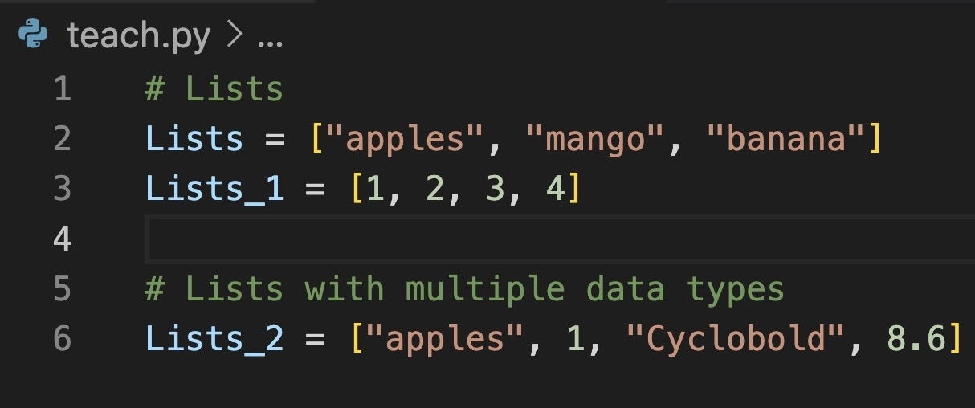
Lists
Lists are ordered collection of items.
They can contain different data types.
You define lists with square brackets.

Slide 9
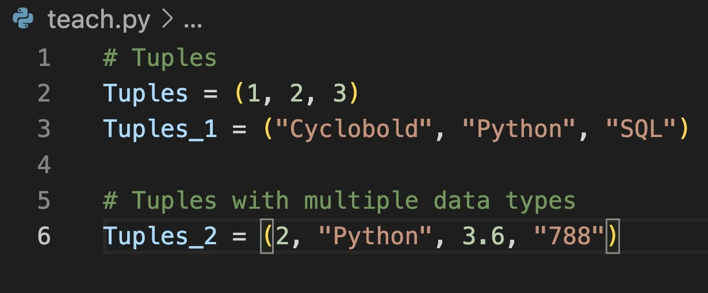
Tuples
Tuples are an immutable data type.
They are similar to lists but cannot be changed after creation.
They support indexing and slicing.
Tuples are defined using normal brackets.

Slide 10
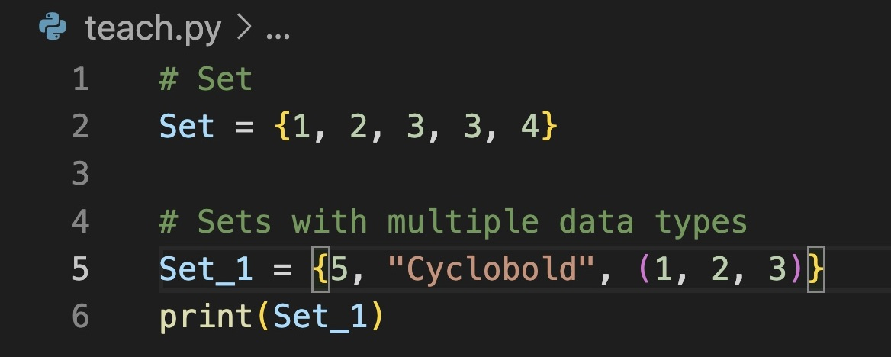
Sets
Sets are unordered collections of unique items.
Sets are defined by curly braces.
They can also contain multiple data types.

Slide 11
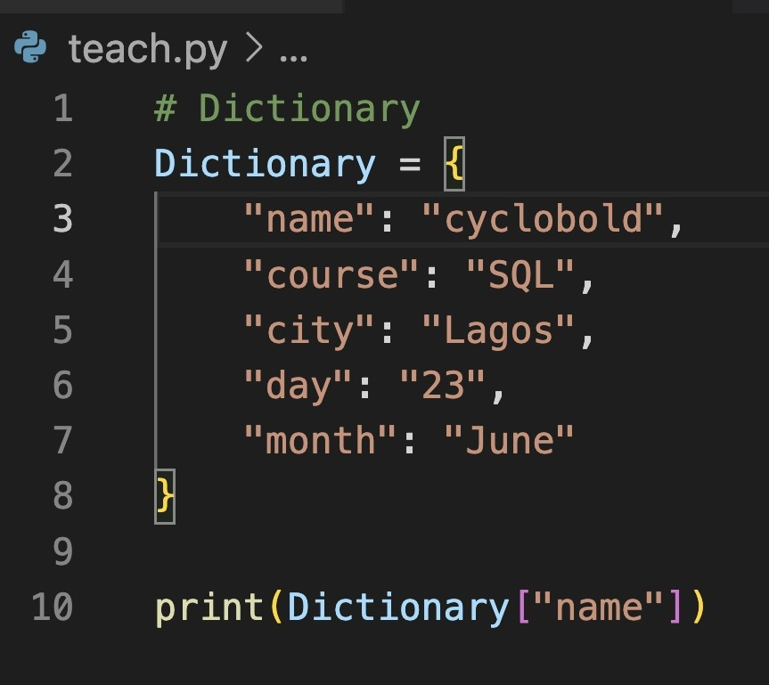
Dictionaries in Python
Dictionaries are ordered collections of key value pairs.
They can also contain multiple data types.
Dictionaries are accessed via keys instead of indices.
Defined by curly braces.
Keys in dictionaries should be unique and immutable.

Slide 12
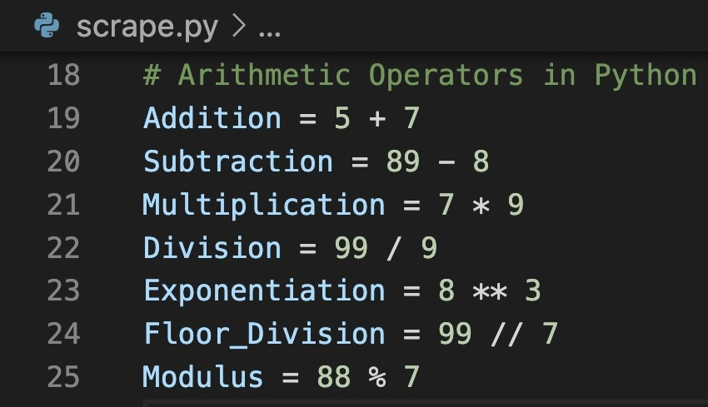
Arithmetic Operations in Python
Arithmetic operations in python are done using : addition, subtraction, division, multiplication, exponentiation, floor division and modulus.
It is important to understand arithmetic operations in Python as it is fundamental for performing calculations and working with numerical data in your code.
The order of operations with arithmetic operations using python follows the PEMDAS/BODMAS rule.

Slide 13
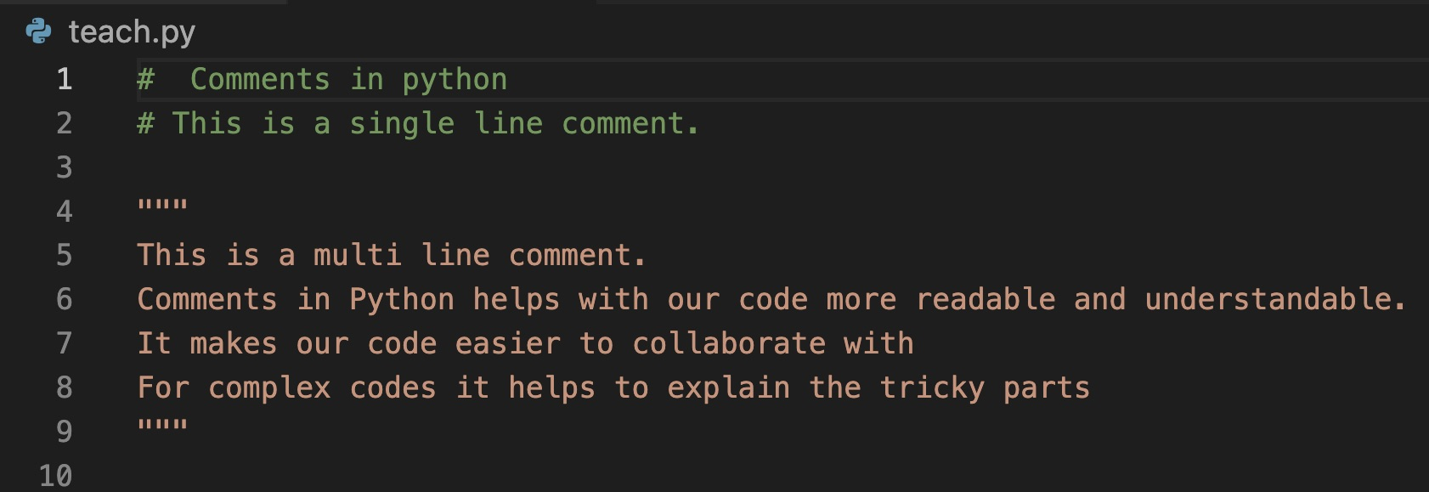
Comments in Python
Comments in Python helps with our code more readable and understandable.
It makes our code easier to collaborate with.
For complex codes it helps to explain the tricky parts that might not be easily understood by others.

Slide 14
Summary
We have covered the fundamental concepts essential for programming in python
The fundamental aspects of python being: Variables , data types, data structures in python, arithmetic operations in python and comments for best practices.
Mastering these basics will lay a solid foundation for exploring Python and its uses.

Slide 15
Assignments
Explain in details data types with examples.
Type cast at least ten different variable from one data type to another.
Create lists, tuples, sets and dictionaries in python using multiple data types.
Practice string concatenation in python( do at least 10).
Save your file in a single folder called cyclo_assignments.
Use comments to explain your code properly.

Slide 16
THE END

